Slide 1

RAG-based System Studying Immune Response to Influenza Virus

Slide 2

RAG architecture with Source + Citation

Slide 3
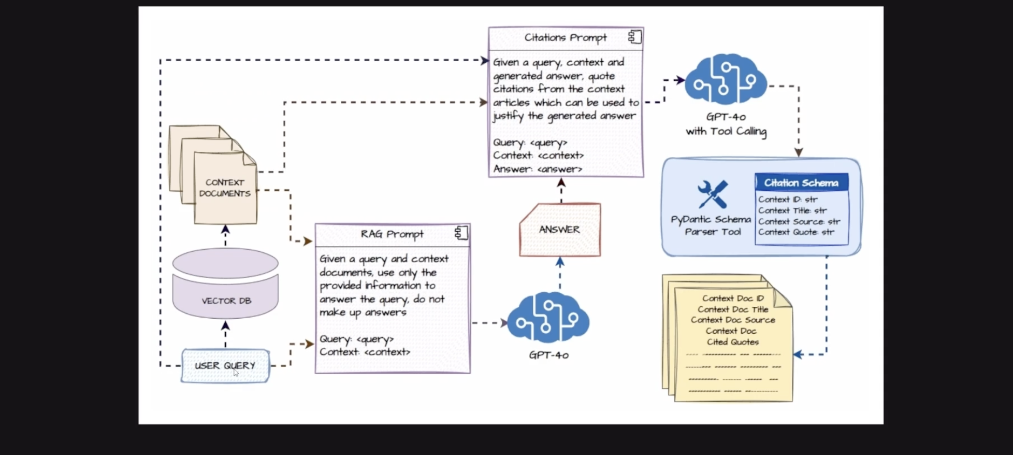
Overall RAG Flow

Slide 4
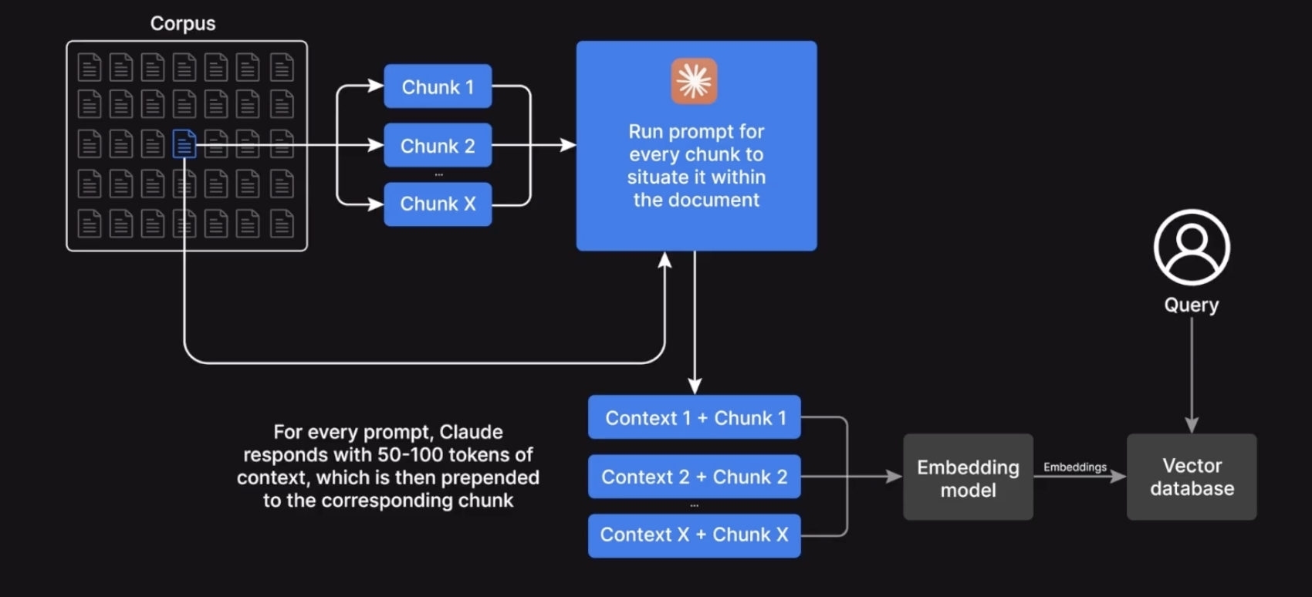
Step 1: Contextual Retrieval Workflow

Slide 5
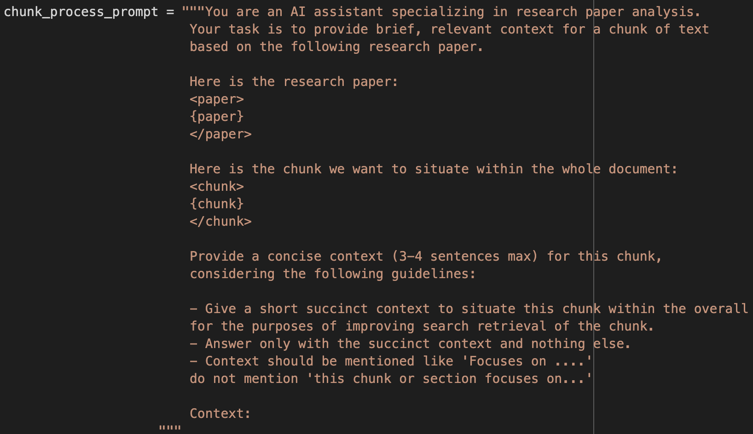
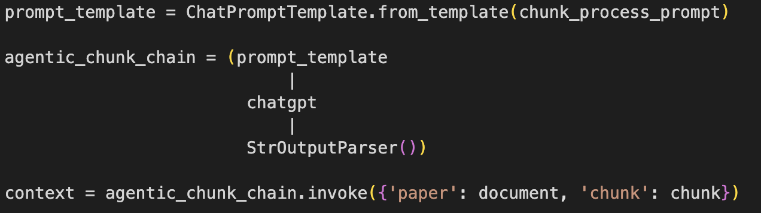
Step 1: Contextual Retrieval Workflow Implementation

Slide 6
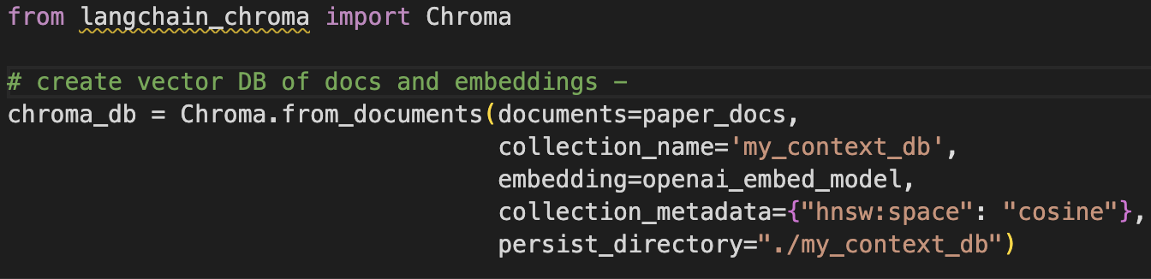
Step 2: Chunk+Context Embeddings

Slide 7
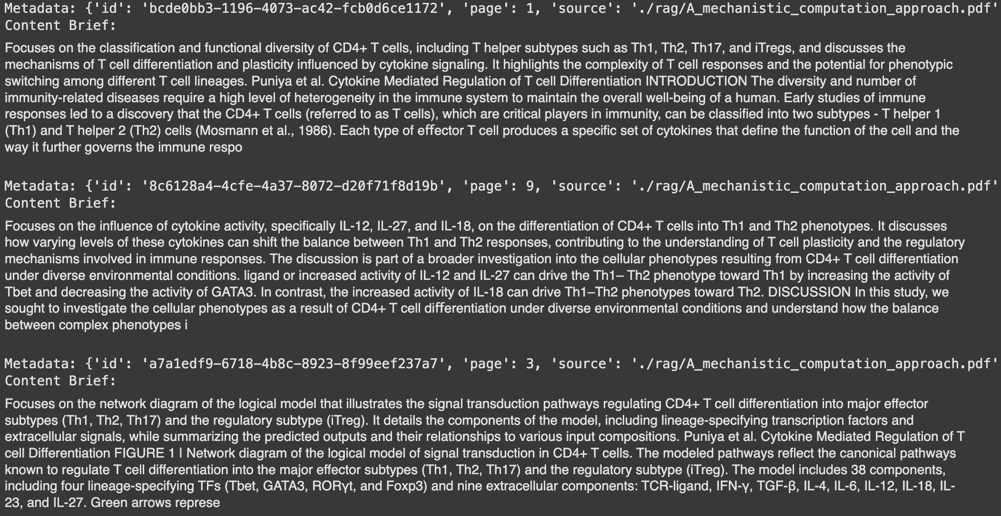
Step 3: Sematic Similarity-based Retrieval System

Slide 8
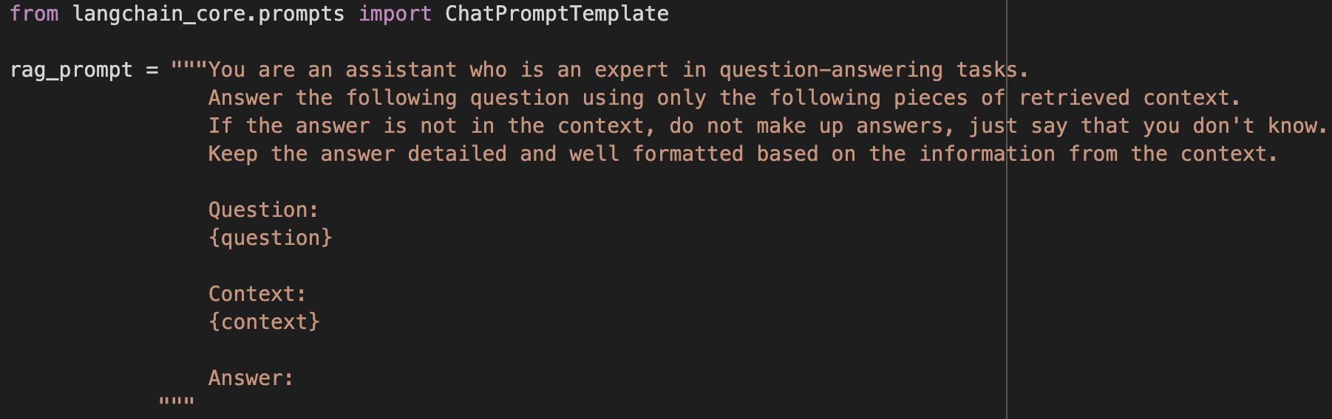
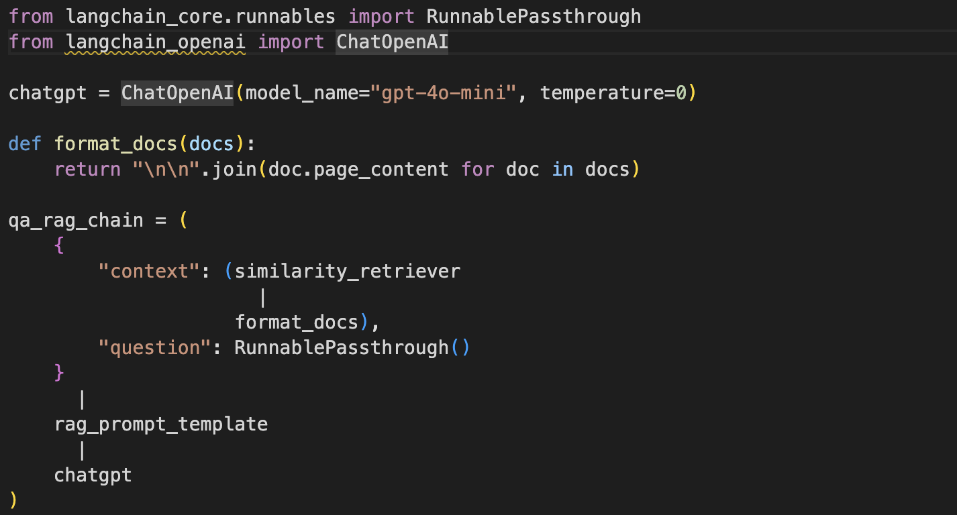
Step 4: Simple RAG System

Slide 9
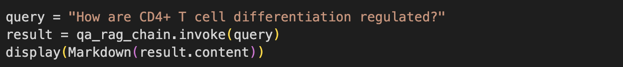
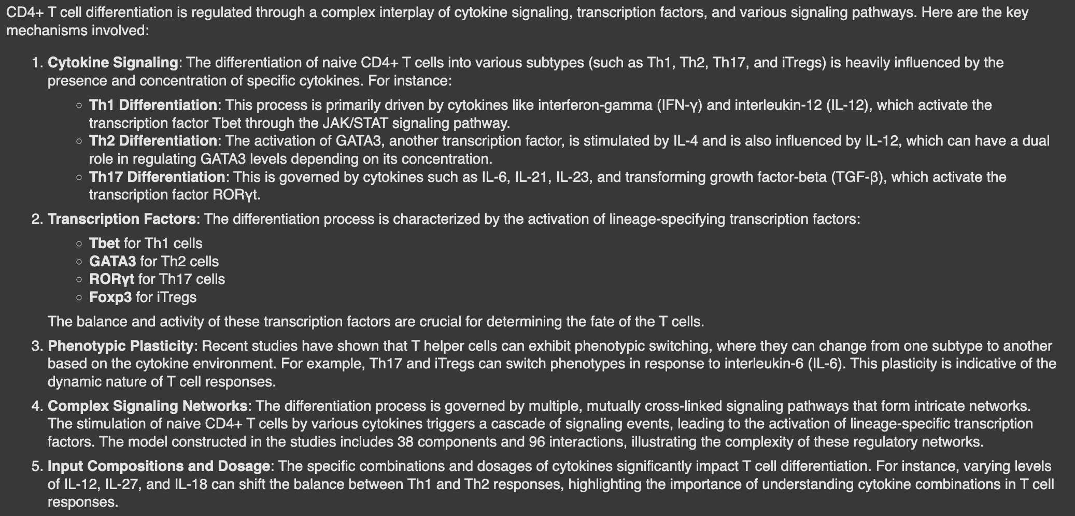
Step 4: Simple RAG System Testing

Slide 10
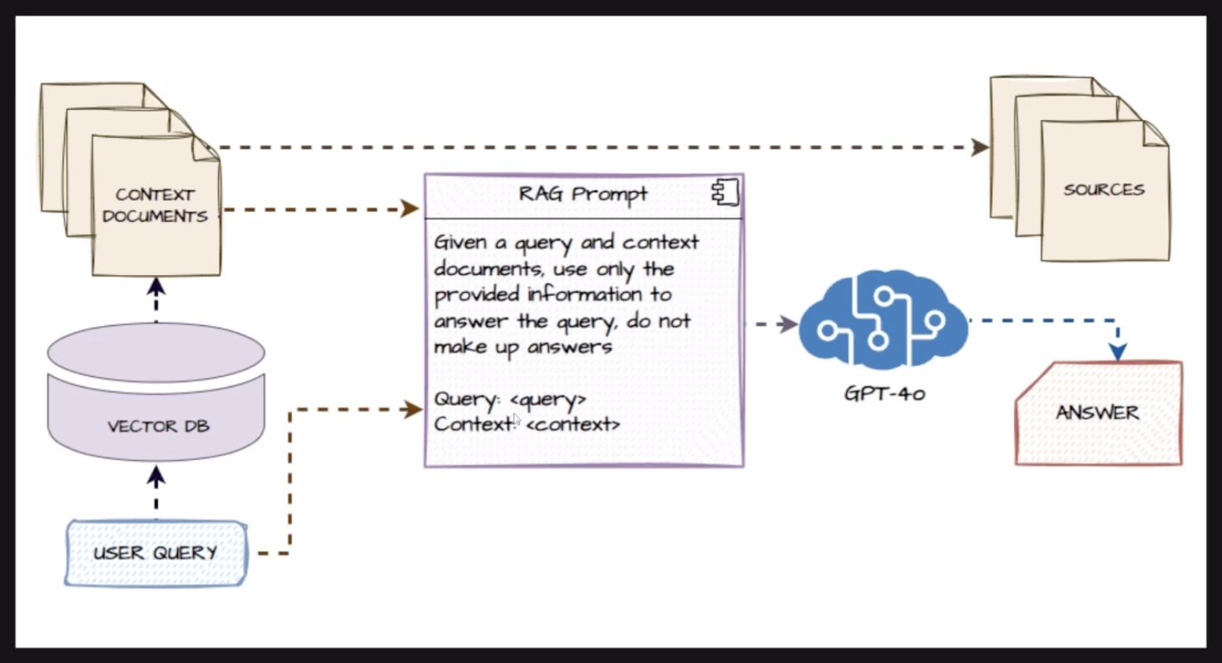
Part 2: RAG + Sources

Slide 11
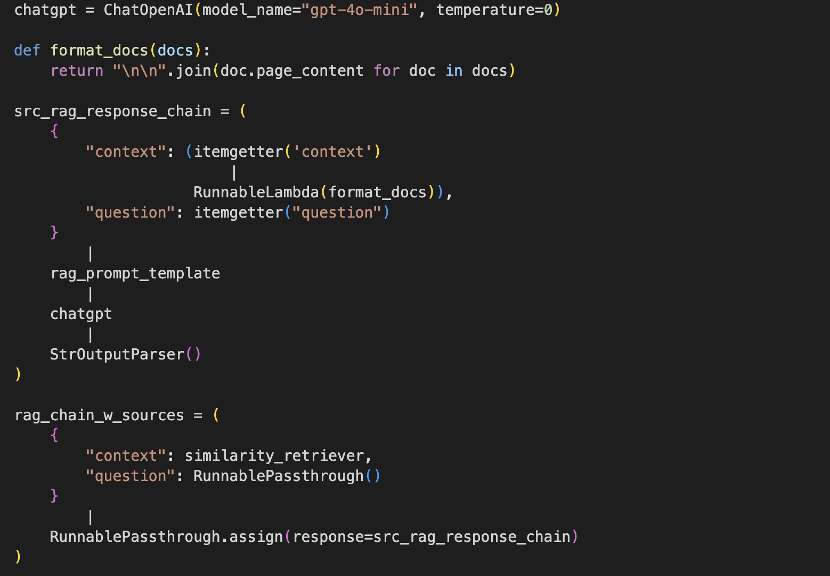
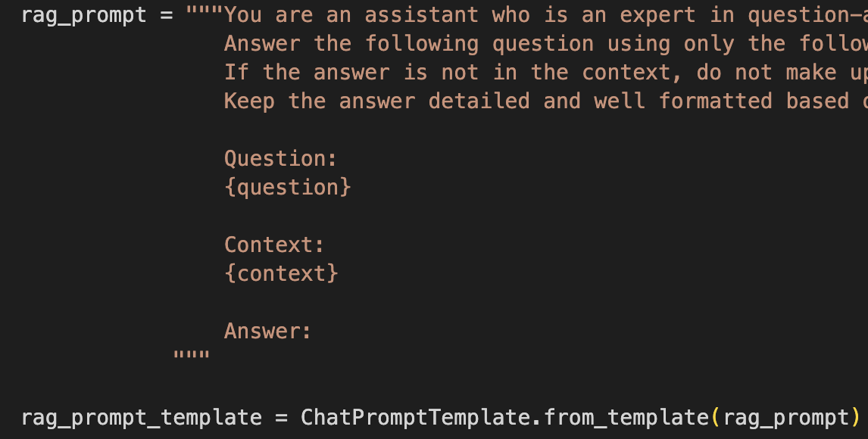
Step 5: RAG + Source

Slide 12
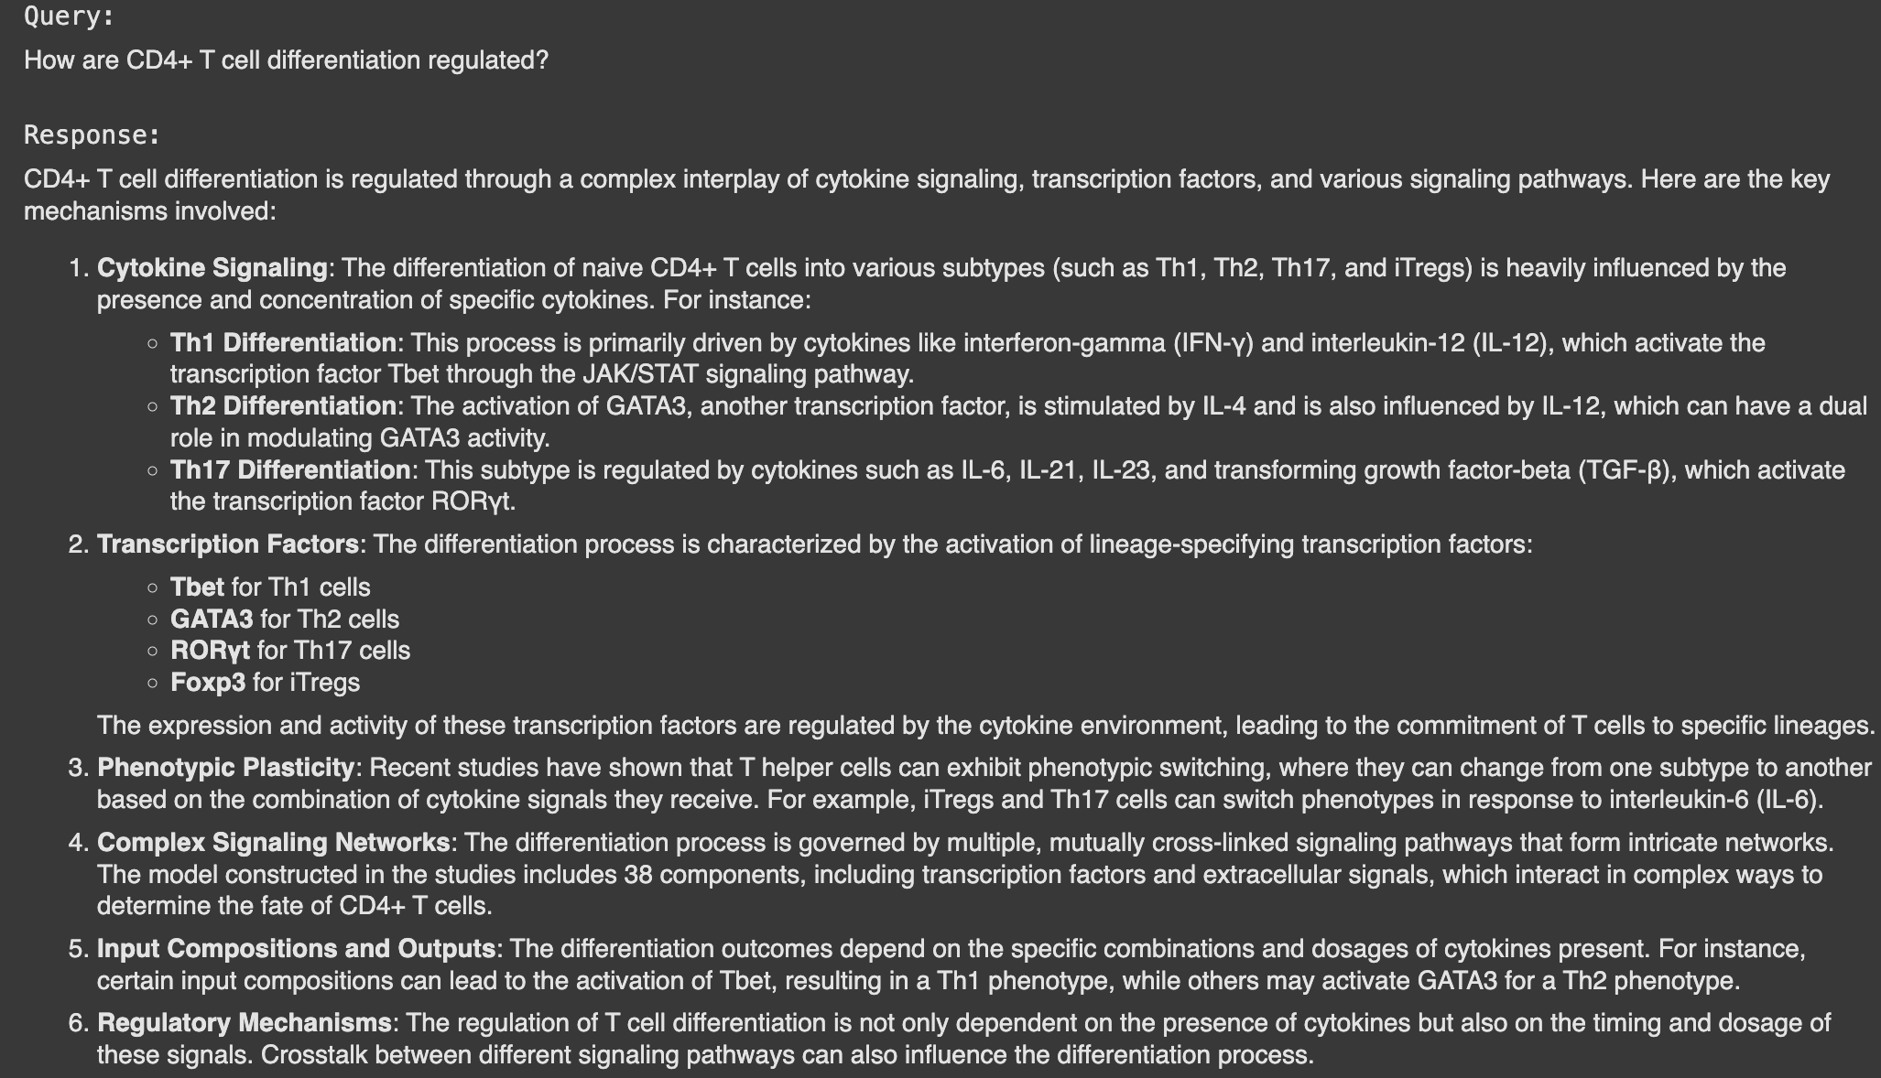
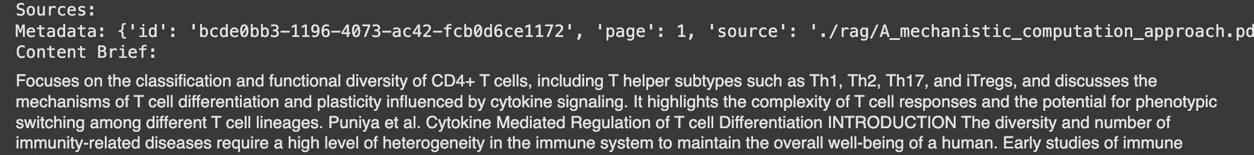
Step 5: RAG + Source Testing

Slide 13
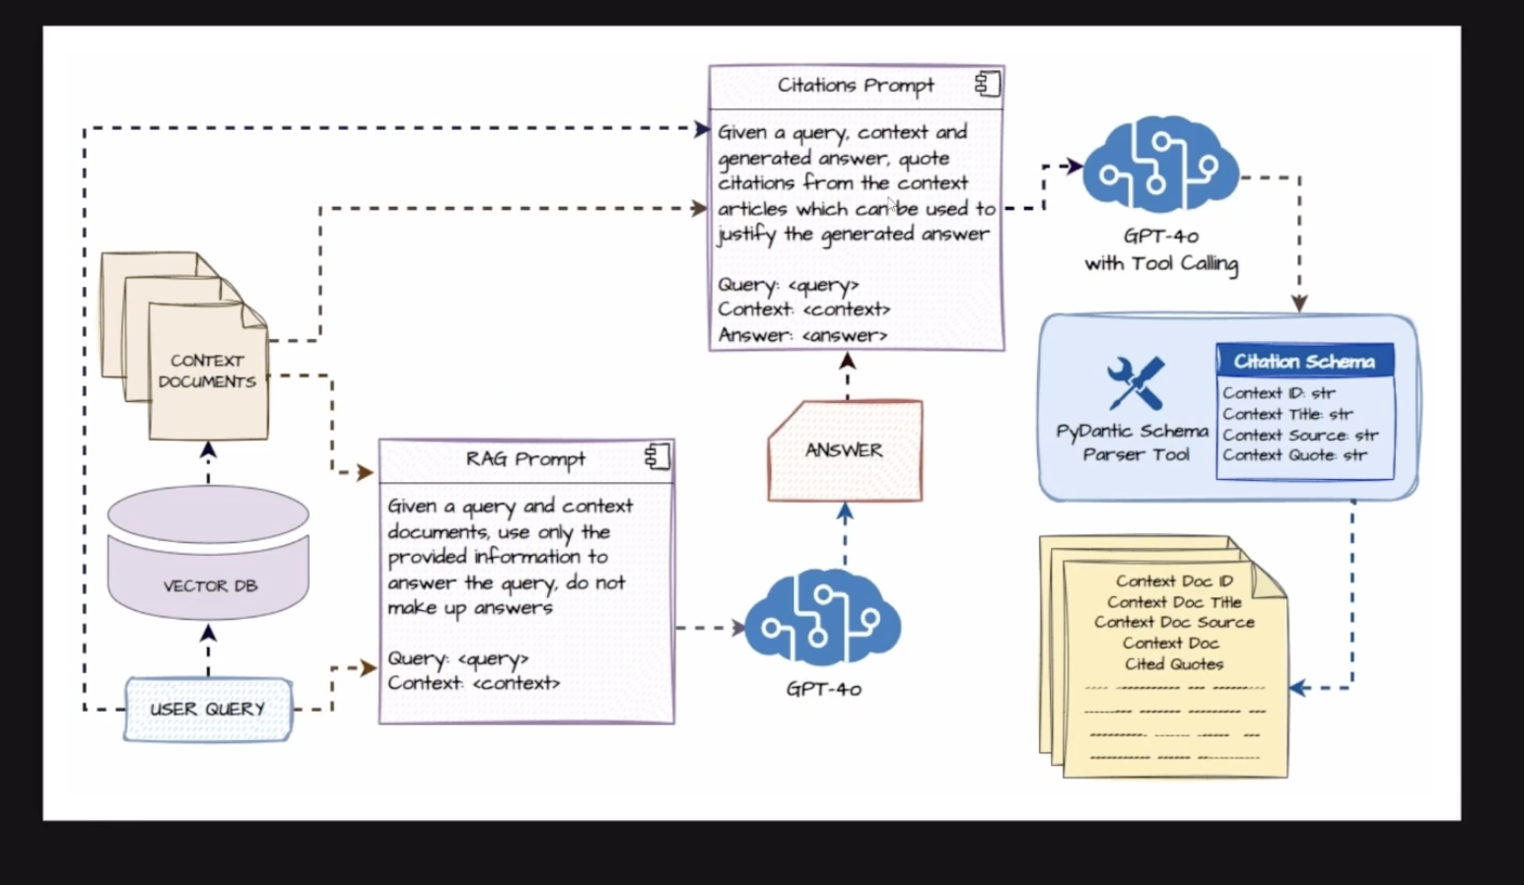
Part 3: RAG + Sources + Citation

Slide 14
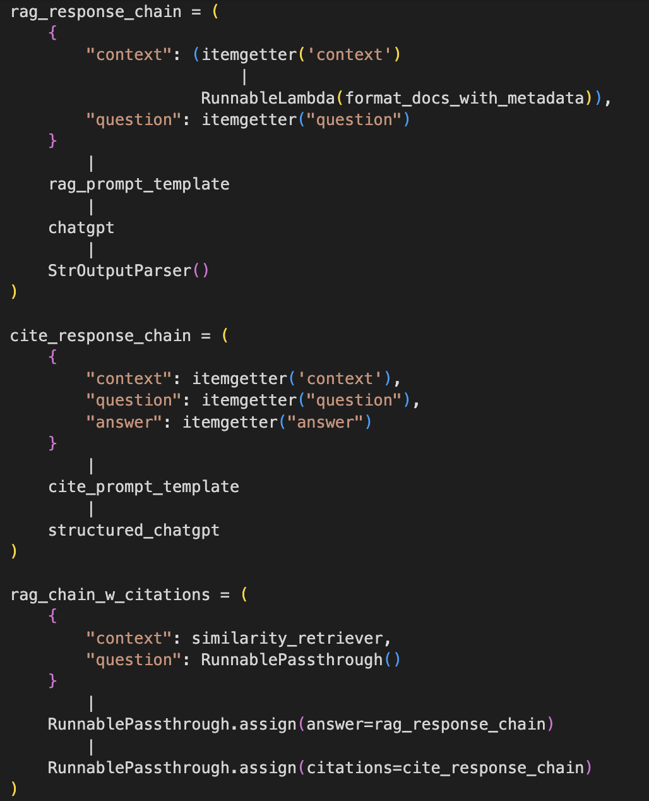
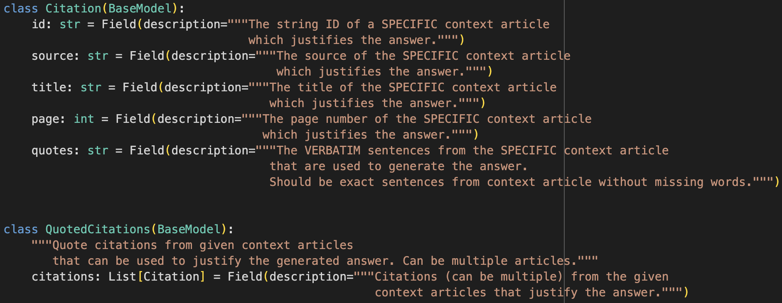
Step 6: RAG + Sources + Citation

Slide 15
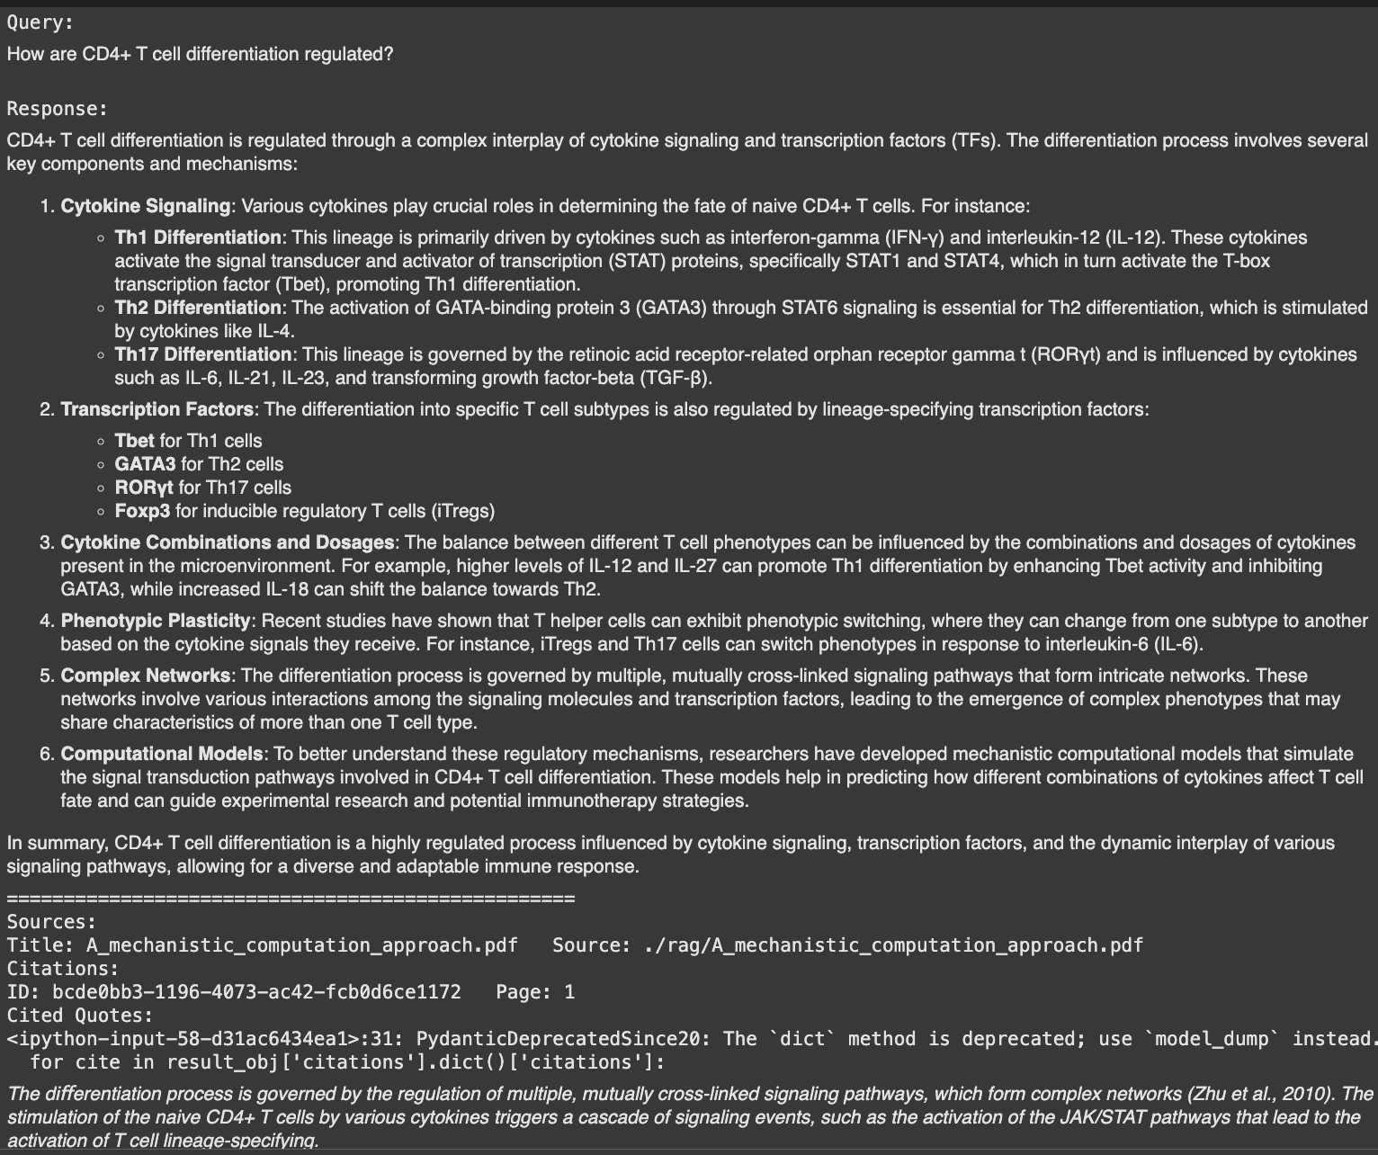
Step 6: RAG + Sources + Citation

Slide 16
Step 7: Deployment

Slide 17
RAG-based Text-to-SQL for retrieving patient Immune Score

Slide 18
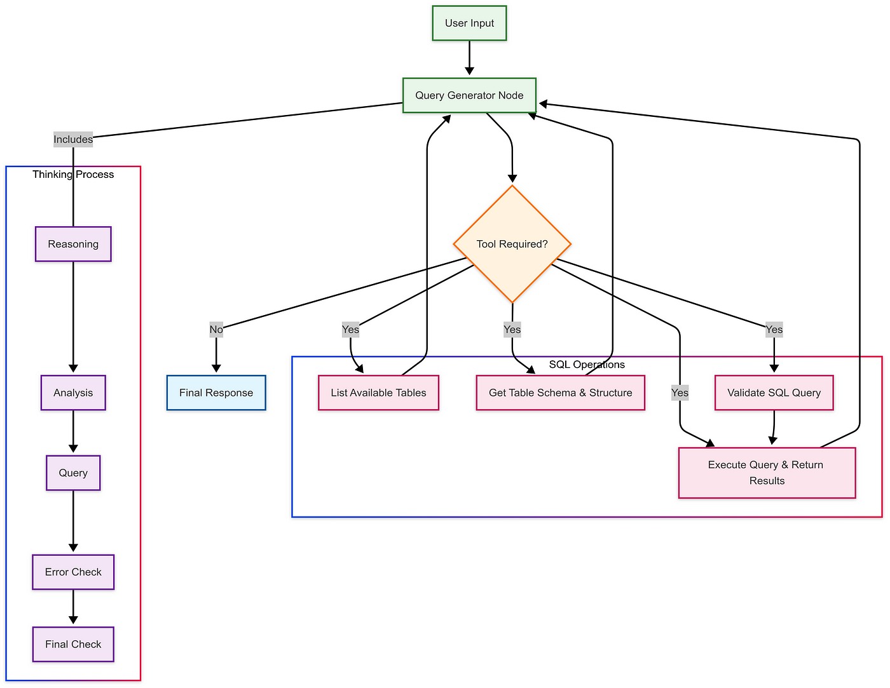
Lang Graph architecture for retrieving aggregated Immune scores from SQL database

Slide 19
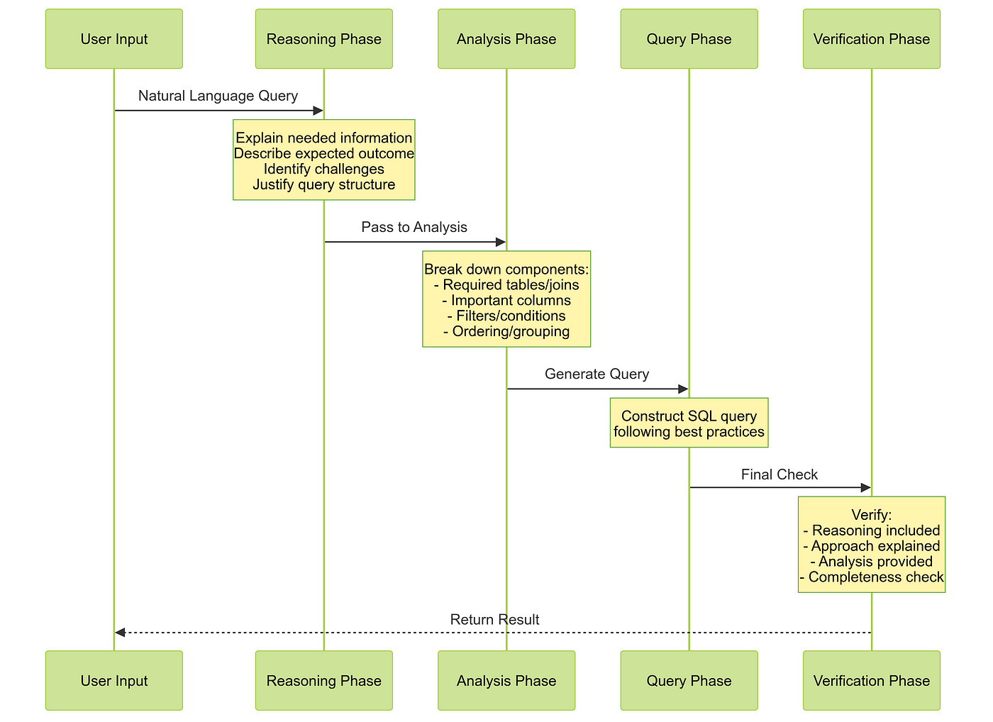
Implementation of architecture

Slide 20
Implementation of architecture
Reasoning Phase:
Explains information needs
Describes expected outcomes
Identifies challenges
Justifies approach
Query Phase
Constructs SQL following rules:
SELECT statements only
Proper syntax
Default LIMIT 10
Verified schema
Analysis Phase
Tables and joins needed
Required columns
Filters and conditions
Ordering/grouping logic
Verification Phase
Validates reasoning
Confirms approach
Checks completeness
Verifies output

Slide 21
Sample Results on a dummy database
The query successfully returned the top 5 best-selling tracks by revenue. Here are the results: 1. **The Woman King** - $3.98 2. **The Fix** - $3.98 3. **Walkabout** - $3.98 4. **Hot Girl** - $3.98 5. **Gay Witch Hunt** - $3.98 All tracks generated the same revenue, which indicates that they may have been sold in equal quantities or at the same price point. Everything is in order, and I have verified all steps. Based on my analysis, here's the SQL query that will answer your question: SELECT t.TrackId, t.Name, SUM(il.UnitPrice * il.Quantity) AS TotalRevenue FROM Track t JOIN InvoiceLine il ON t.TrackId = il.TrackId GROUP BY t.TrackId, t.Name ORDER BY TotalRevenue DESC LIMIT 5;

